Slide 1
Final Project
Kunal Sharma

Slide 2
Approach
Web Scaring of product with more than 5000 reviews using “Rvest"
Stemming of positive and negative lexicons
cleaning the data and tokenizing, stemming and removing stop words
Calculate the positive and negative percentage of sentiments in all reviews
Calculating score to find the sentiment of the reviews
Plotting a Bar Plot to display overall Positive and Negative Sentiments

Slide 3
Data
Source of data: Amazon.com
Web scraping using “rvest” package
Fujifilm INSTAX Mini 8 Instant Camera (Blue)
https://www.amazon.com/Fujifilm-INSTAX-Mini-Instant-Blue/productreviews/B00AWKJPOA/ref=cm_cr_arp_d_show_all?ie=UTF8&reviewerType=all_reviews&pageNumber=
Description:
Total No of Positive reviews : 9194
Total No of Negative reviews : 1055

Slide 4
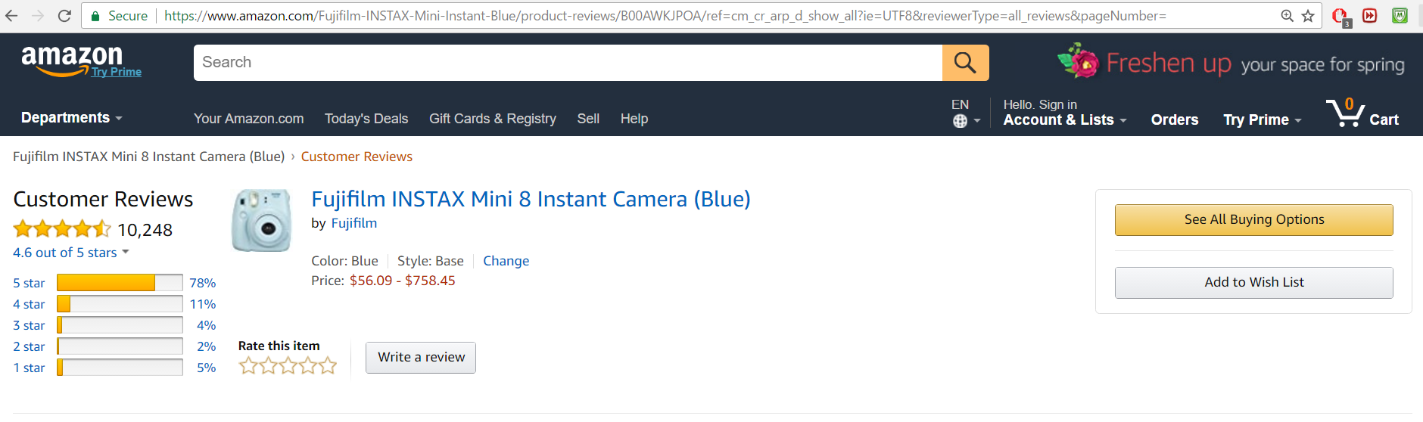
Product from Amazon with 10248 reviews

Slide 5
Scrape reviews
library(NLP)
library(tm)
library(Rvest)

Slide 6
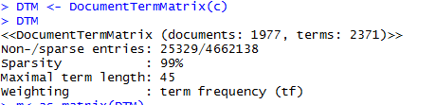
DocumentTermMatrix
A document matrix is created which is a numeric matrix containing a column for each different word in the whole corpus, and a row for each document

Slide 7
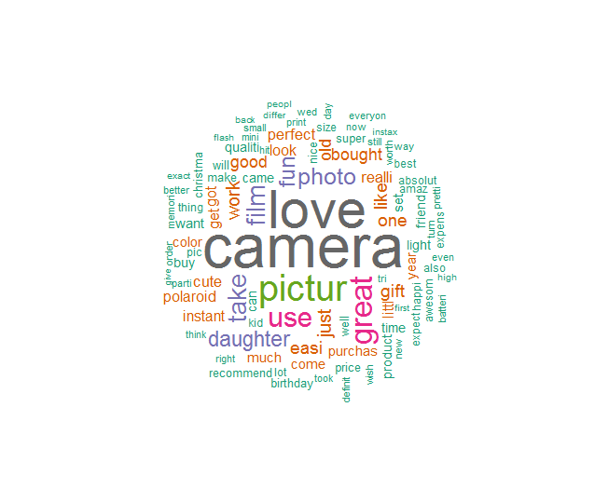
WordCloud
Plot a cloud comparing the frequencies of words across documents
The WordCloud is generated to visualize the sentiments of people giving reviews

Slide 8
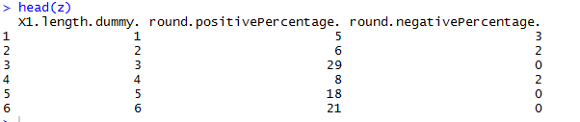
Sentiment in Percentage
positive and negative percentage of sentiments in all reviews

Slide 9
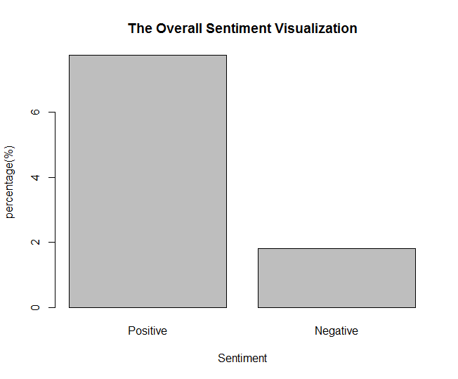
Overall Sentimental Visualization

Slide 10
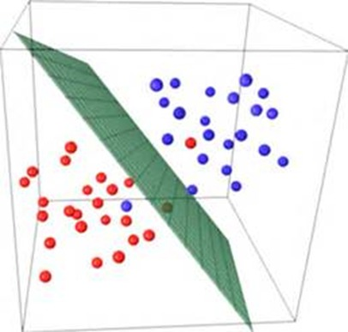
SVM
A Support Vector Machine (SVM) is a discriminative classifier formally defined by a separating hyperplane
Library(caret), Library(e1071)

Slide 11
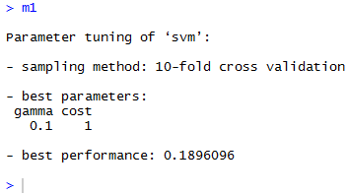
SVM tuning
We tune the SVM model to find the optimum value of the gamma and cost that can be used for the SVM model with the kernel
After finding the optimum gamma and cost value, we implement it on the actual SVM model

Slide 12
kernel - type of modelling like linear/radial/polynomial
cost - performance depends on the cost factor. The tune function gives the optimal value of the cost parameter
gamma – It is a parameter of the Gaussian kernel. Default value is (1/dimension of the dataset)
data - specifies which data is to be used to create the model
scale - when scaling is turned off, the feature with the higher values will dominate other features in calculating the distance

Slide 13
Comparison based on kernels
Kernel Type | Accuracy
Linear | 80.66
Radial | 84.99
Polynomial | 79.70
Sigmoid | 84.90

Slide 14
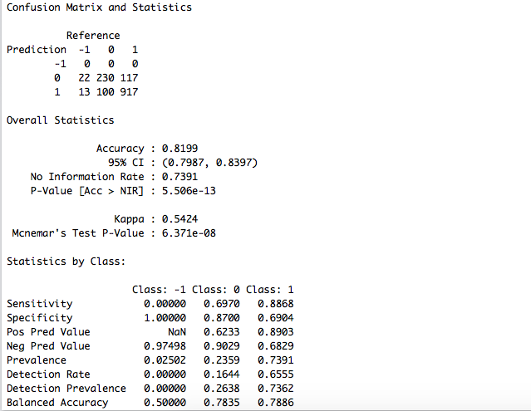
CNN

Slide 15
Thank You

